Slide 1

Five views in eclipse and their uses.
By:Oliver Nan

Slide 2
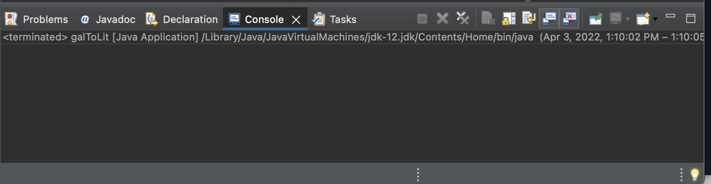
View 1-Console
The console view is found under where you can edit code in eclipse in the tab labeled “Console”. (was here by default)
The main use of the tab is to see what would be printed out to a console (such as command line on windows, or terminal on mac) when running the java program. The console also allows developers to give inputs into the program (just as terminal/command line would) allowing testing of the program with various inputs.

Slide 3
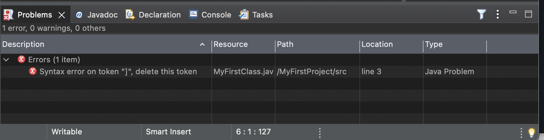
View 2-Problems
The problems view is in the same location as the console view, however it is under the “Problems” tab.
The use of the problems view can be seen in the screenshot provided. The problems view will tell you errors in the syntax of your program (in this case I put a ] where it should not be then saved so that the problems view would display an error). It will also warn you where there are non-critical problems in your program such as not closing the scanner in your program.

Slide 4
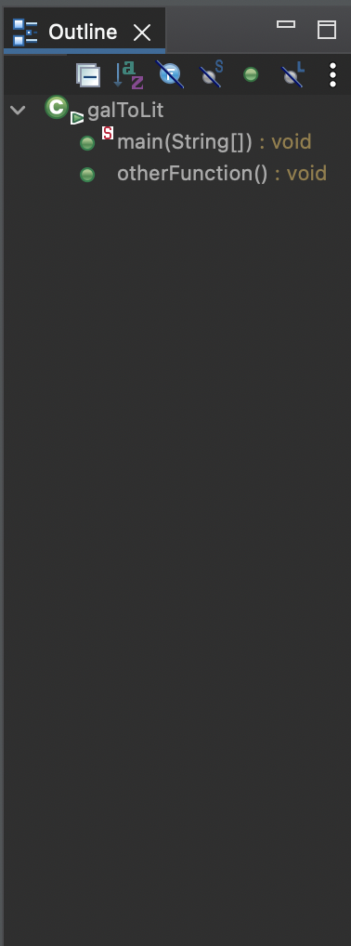
View 3-Outline
The outline view can be found to the right side of the editing space under the “Outline tab”.
The outline view is very useful for larger programs as it displays the functions that a class contains (such as in the example the “main” and “otherFunction”) , and clicking on a function will take you to that function’s location in the code. In programs that contain thousands of lines being able to quickly get to a specific function is very useful. Another benefit of the outline Is that it shows the parameters of a function and its return type for easy viewing.

Slide 5
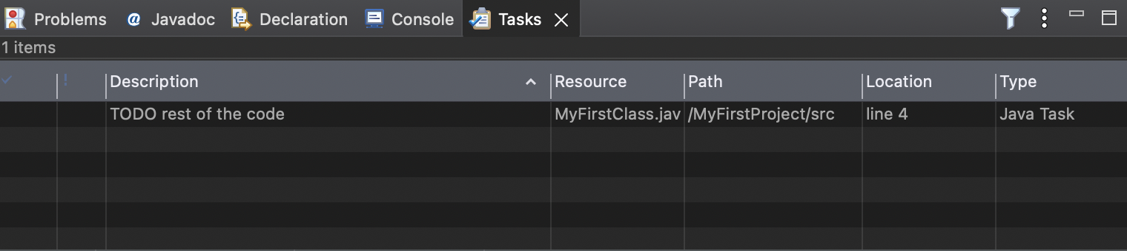
View 4-Tasks
The tasks view is also found in the same under code area as console and problems. The tasks view helps with organization and planning on what needs to be done in your program. You can manually add a task by right clicking then choosing “add task” then you can set the description of the task to whatever you want. You can also type “//TODO (some text here)” then a TODO task will be made in the task list (as shown in the screenshot). You can also set the priority of tasks and mark them as complete to further help with keeping things organized.

Slide 6
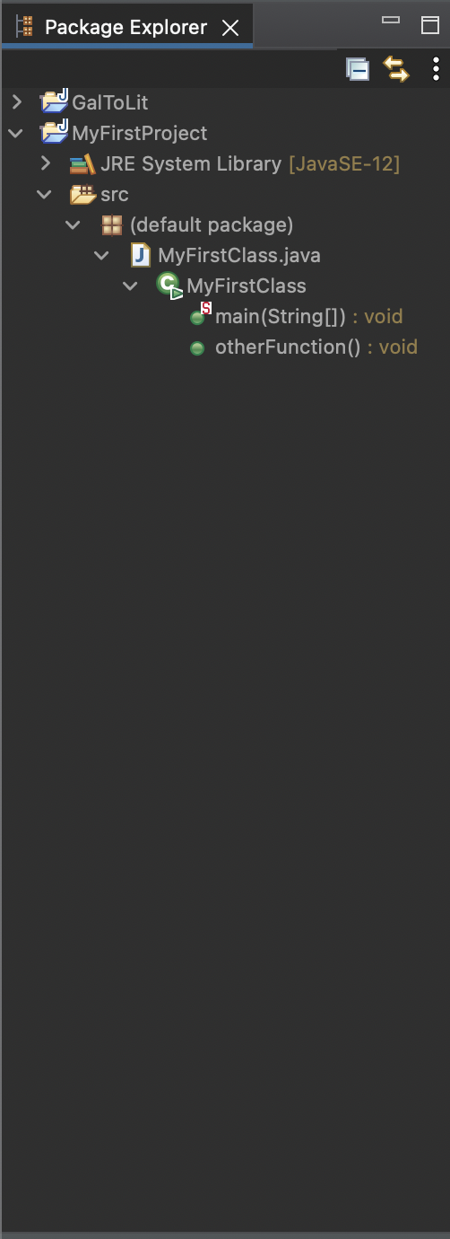
View 5-Package explorer
The package explorer is located to the left of the editing space. The package explorer lets you see all the elements inside of a java project and their hierarchies (e.g “main” is under “MyFirstClass” as “main” is within the class). One very useful thing about this is when developing a project with different classes you can see all the functions in different classes, and can see all the different class within the project.

